Slide 1
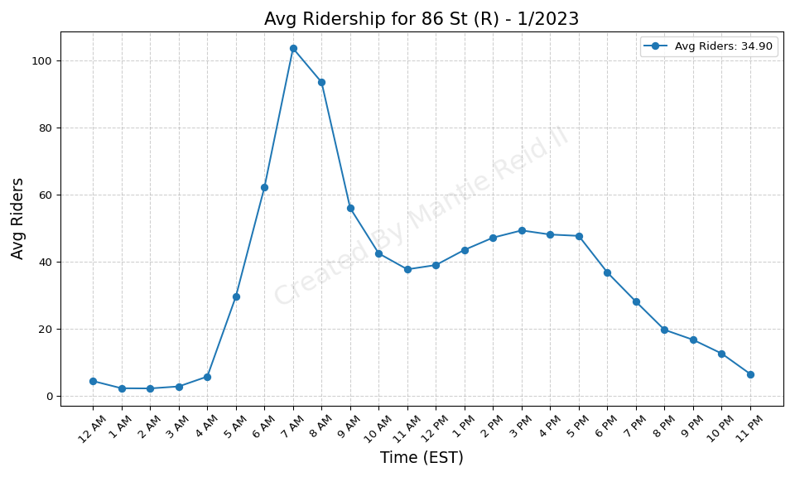
86 St (R) - 1/2023

Slide 2
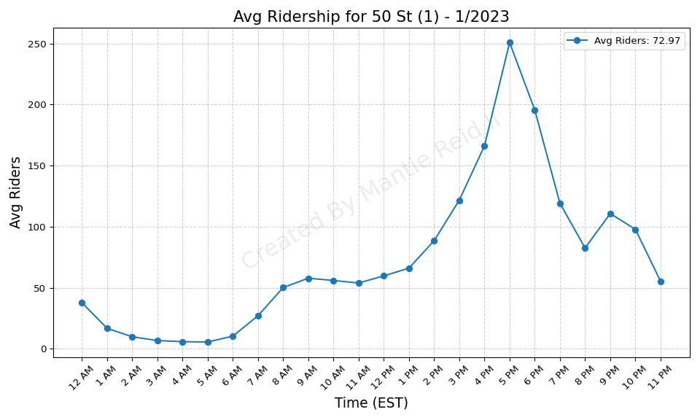
50 St (1) - 1/2023

Slide 3
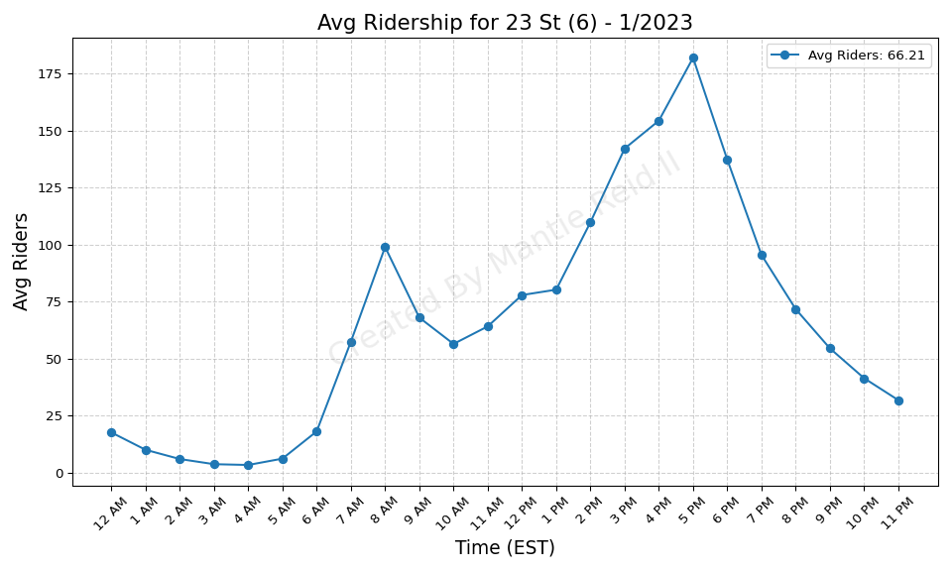
23 St (6) - 1/2023

Slide 4
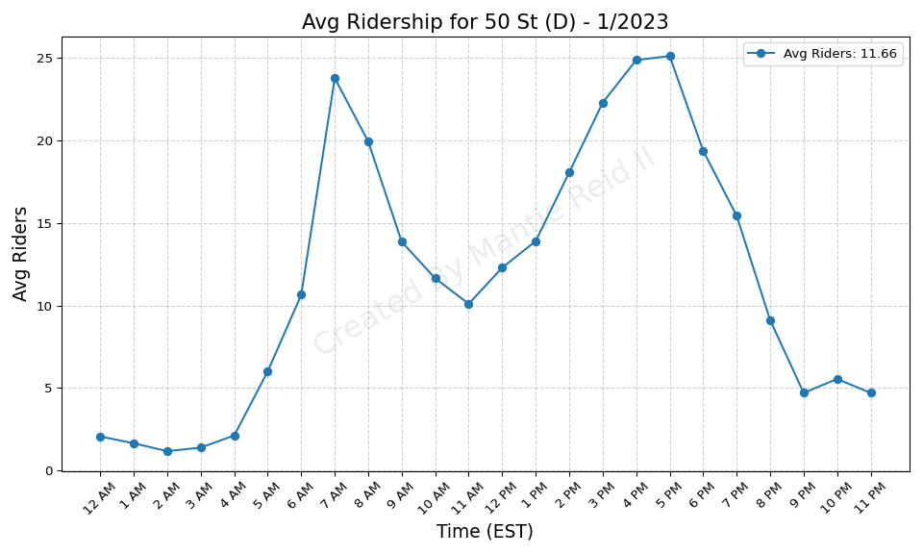
50 St (D) - 1/2023

Slide 5
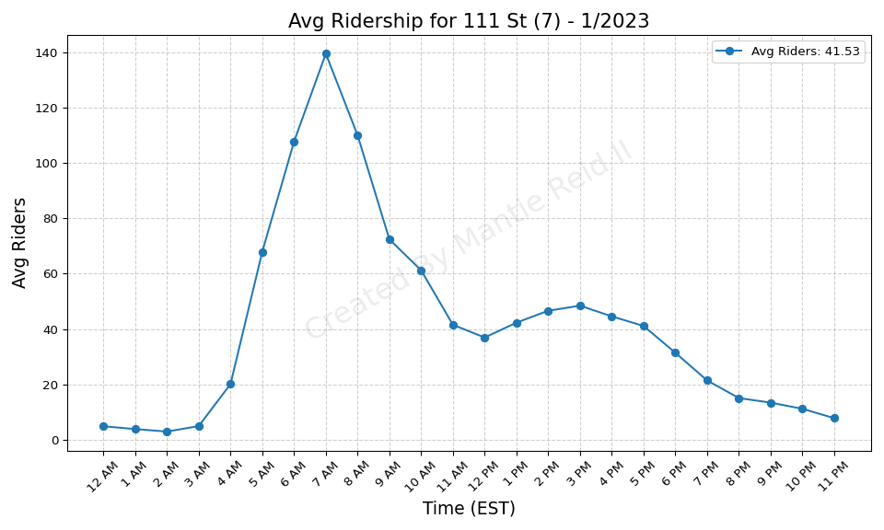
111 St (7) - 1/2023

Slide 6
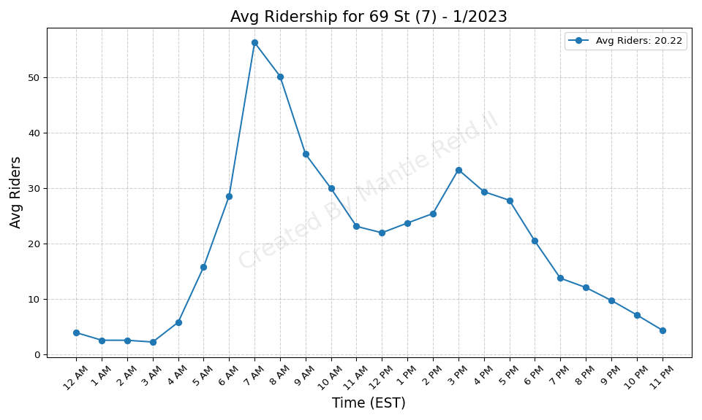
69 St (7) - 1/2023

Slide 7
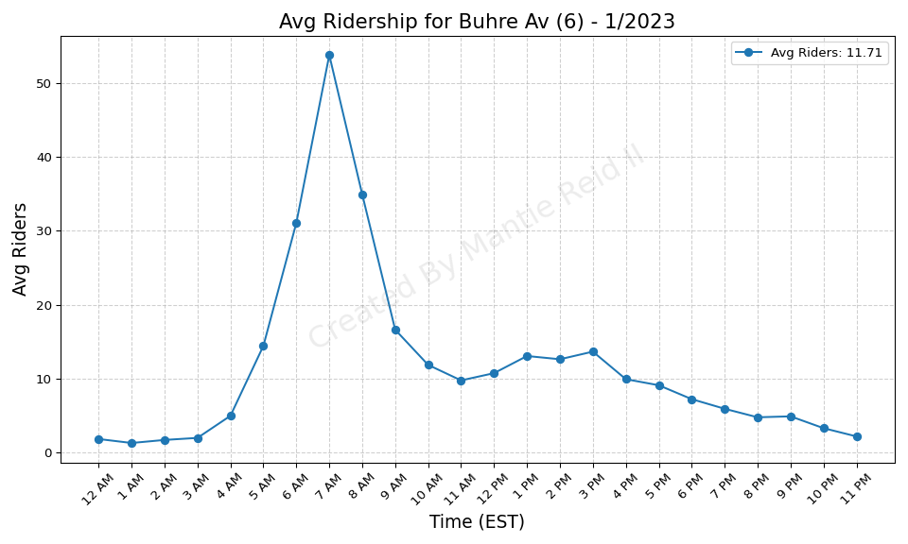
Buhre Av (6) - 1/2023

Slide 8
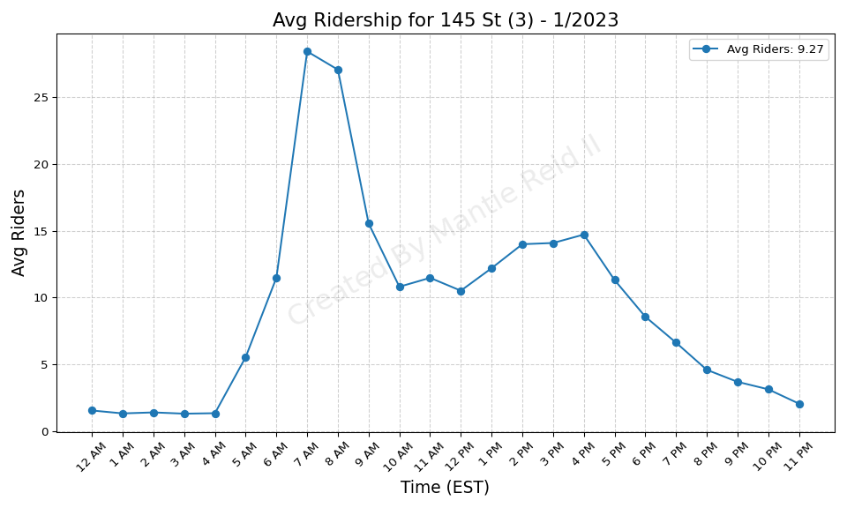
145 St (3) - 1/2023

Slide 9
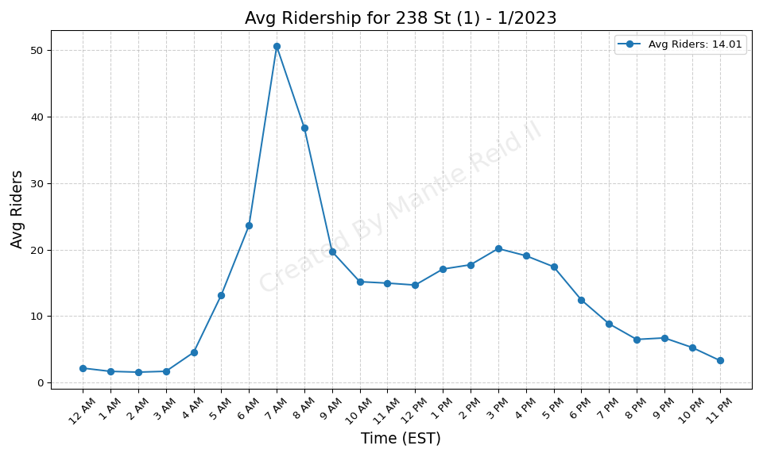
238 St (1) - 1/2023

Slide 10
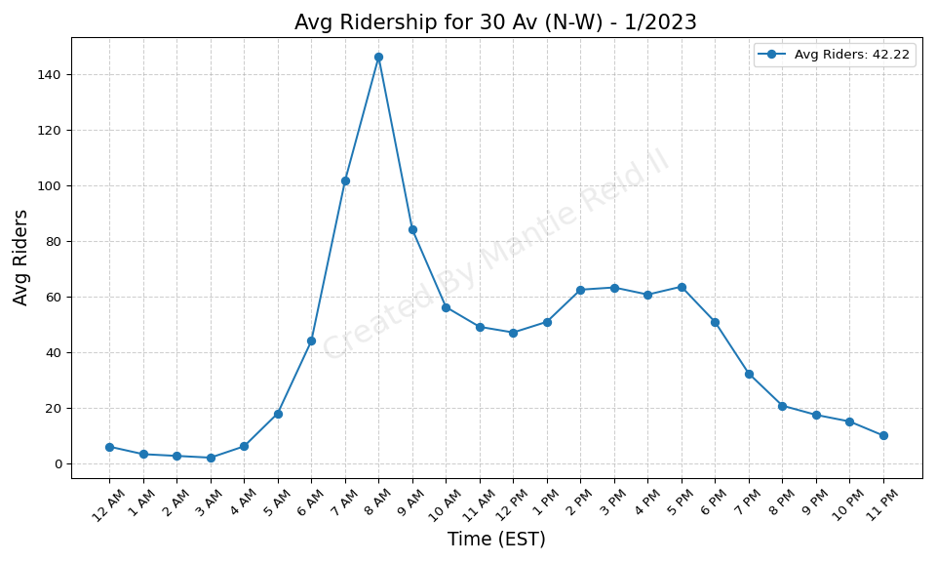
30 Av (N-W) - 1/2023

Slide 11
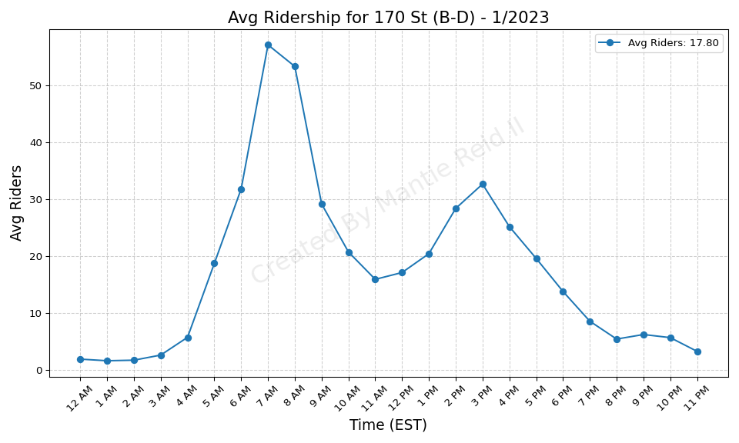
170 St (B-D) - 1/2023

Slide 12
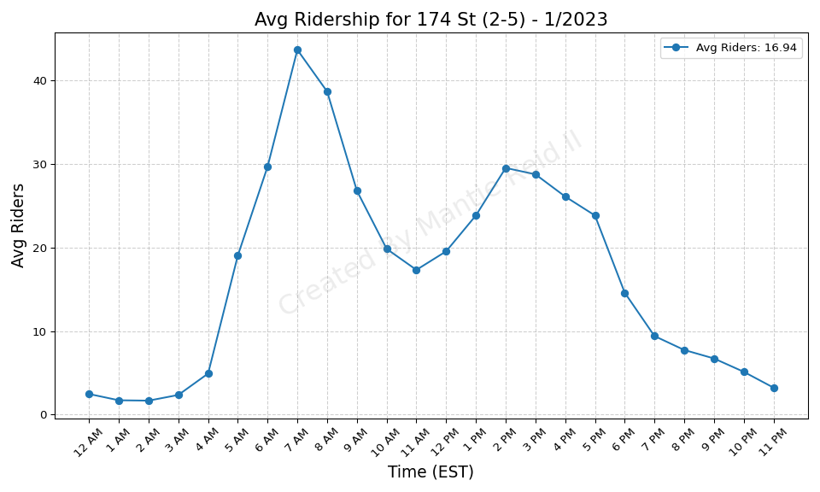
174 St (2-5) - 1/2023

Slide 13
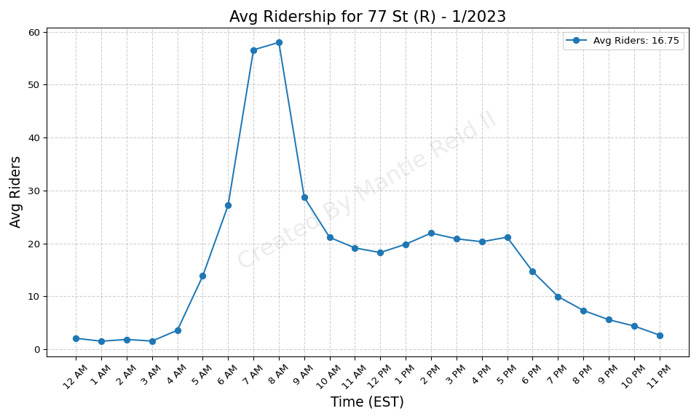
77 St (R) - 1/2023

Slide 14
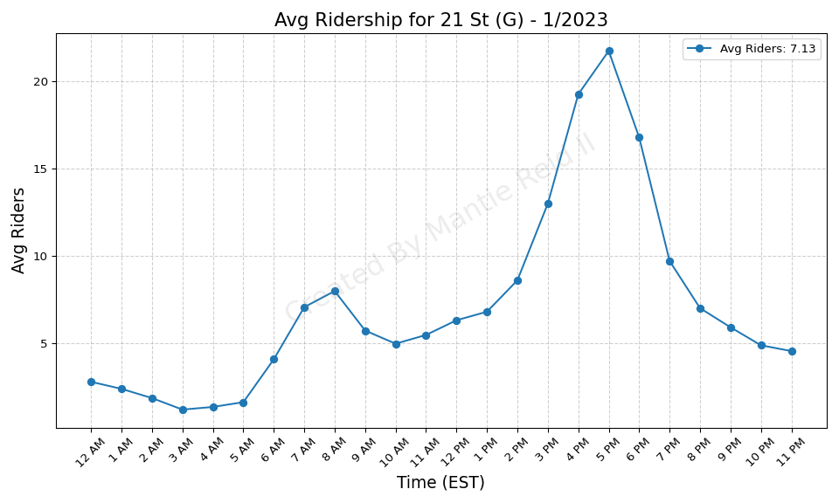
21 St (G) - 1/2023

Slide 15
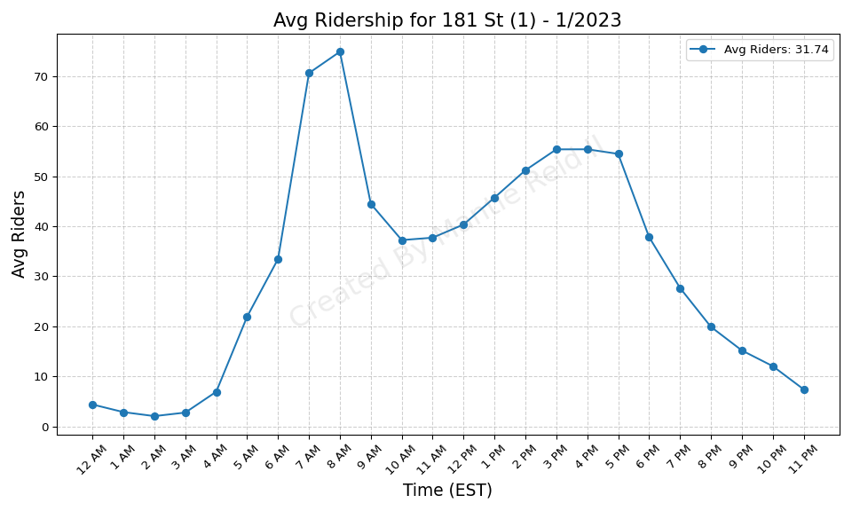
181 St (1) - 1/2023

Slide 16

88 St (A) - 1/2023

Slide 17
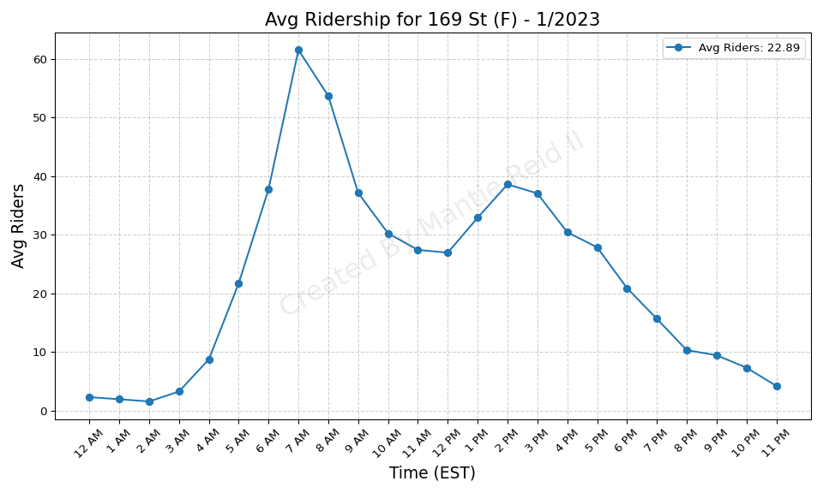
169 St (F) - 1/2023

Slide 18
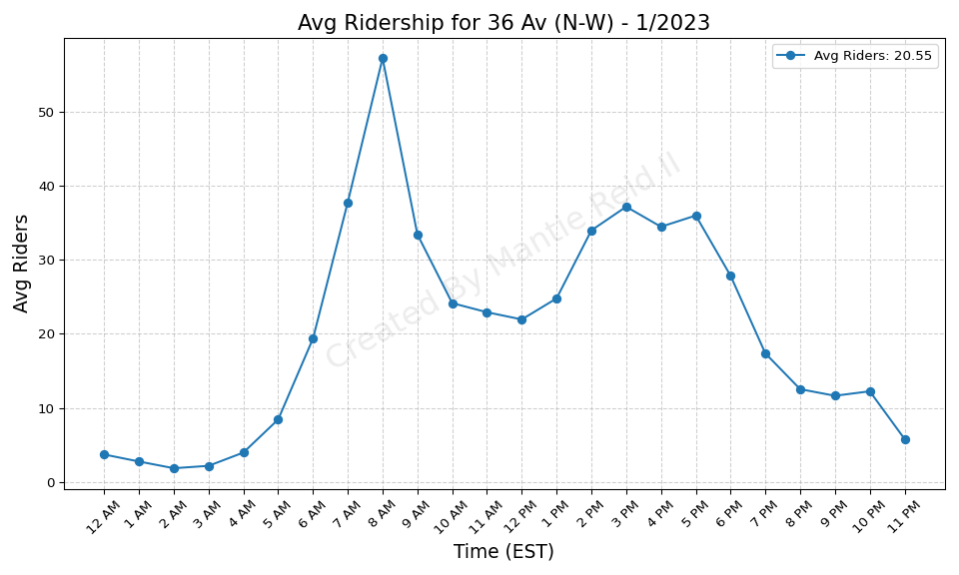
36 Av (N-W) - 1/2023

Slide 19
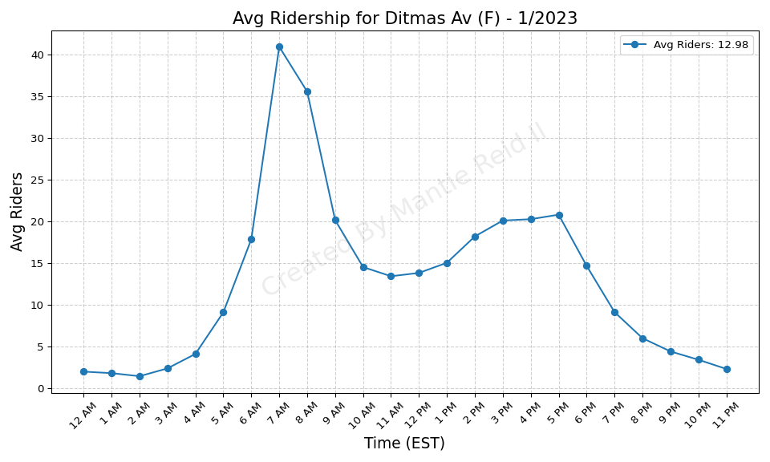
Ditmas Av (F) - 1/2023

Slide 20
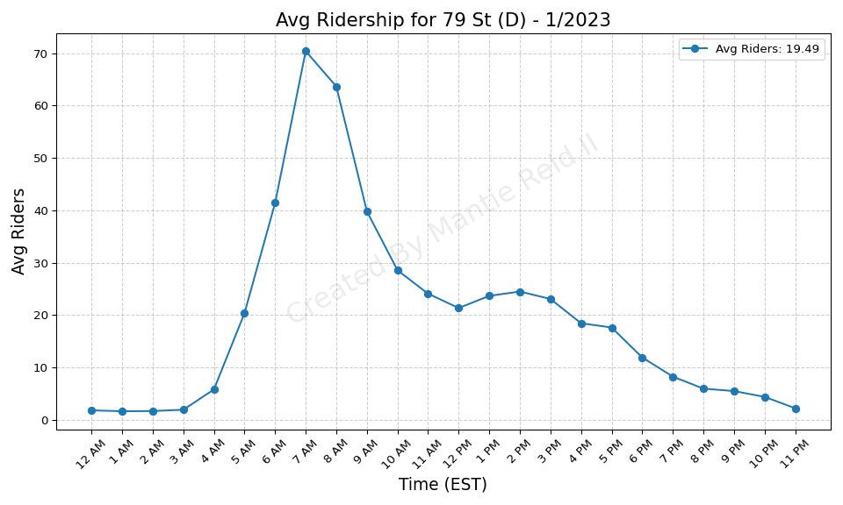
79 St (D) - 1/2023

Slide 21
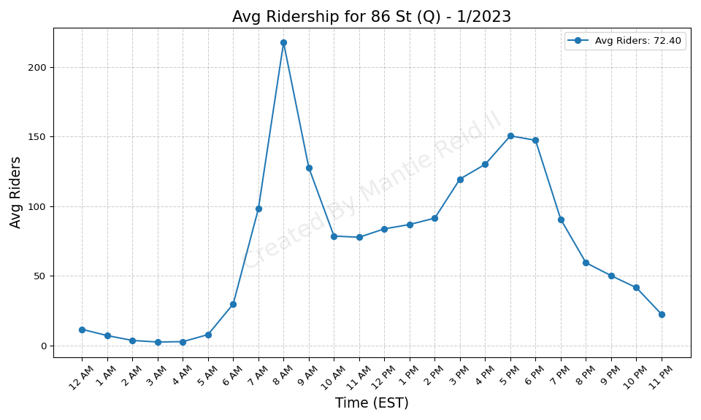
86 St (Q) - 1/2023

Slide 22

25 Av (D) - 1/2023

Slide 23
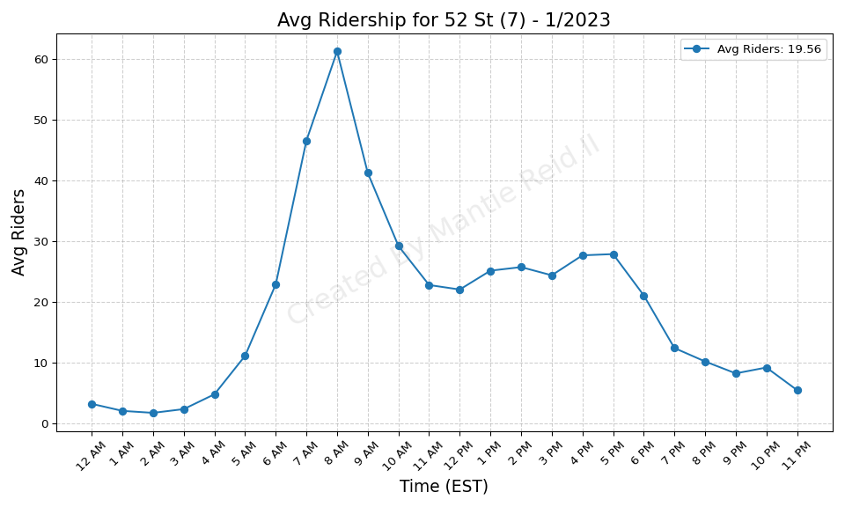
52 St (7) - 1/2023

Slide 24

18 Av (D) - 1/2023

Slide 25
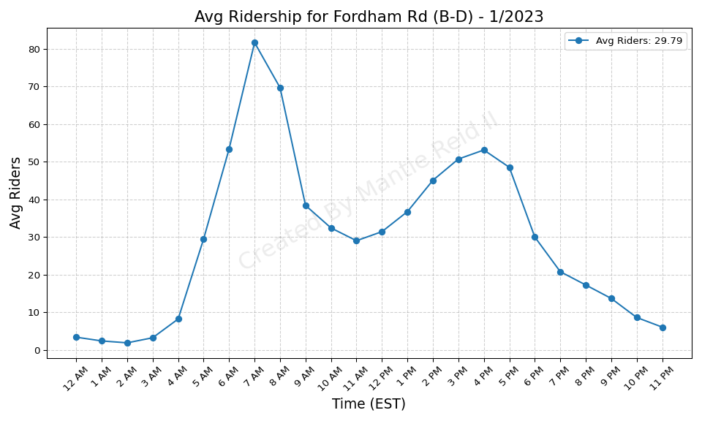
Fordham Rd (B-D) - 1/2023

Slide 26
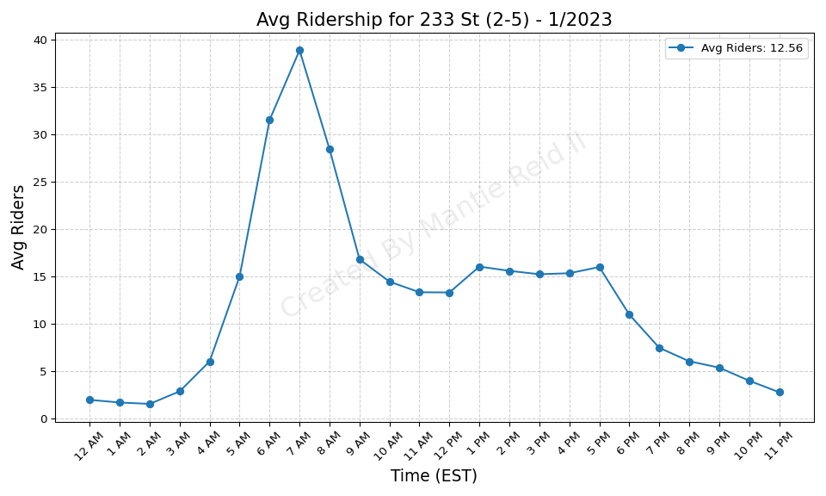
233 St (2-5) - 1/2023

Slide 27
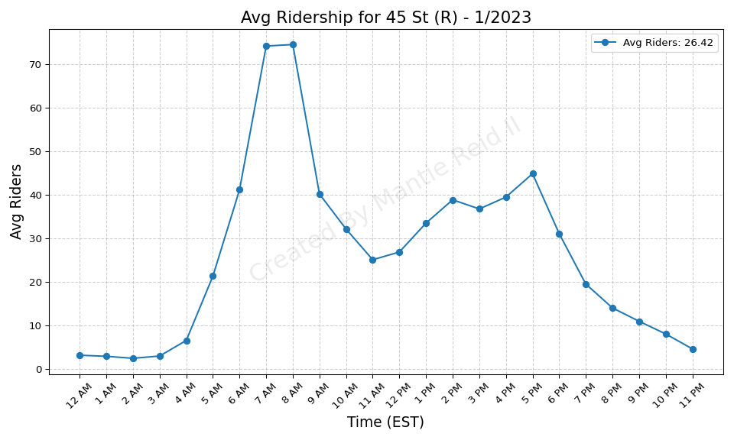
45 St (R) - 1/2023

Slide 28

183 St (4) - 1/2023

Slide 29
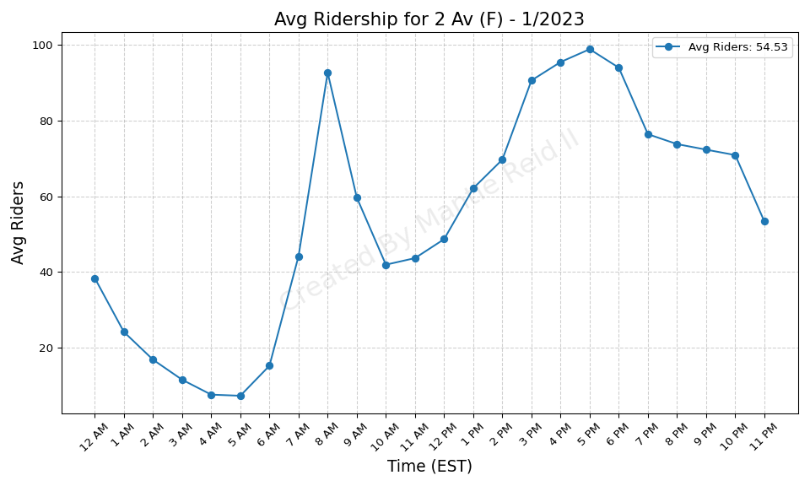
2 Av (F) - 1/2023

Slide 30
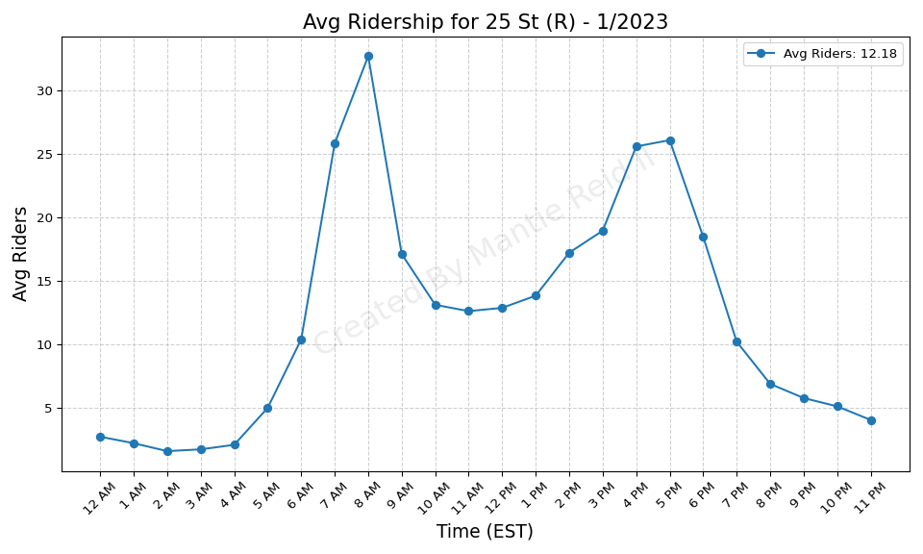
25 St (R) - 1/2023

Slide 31
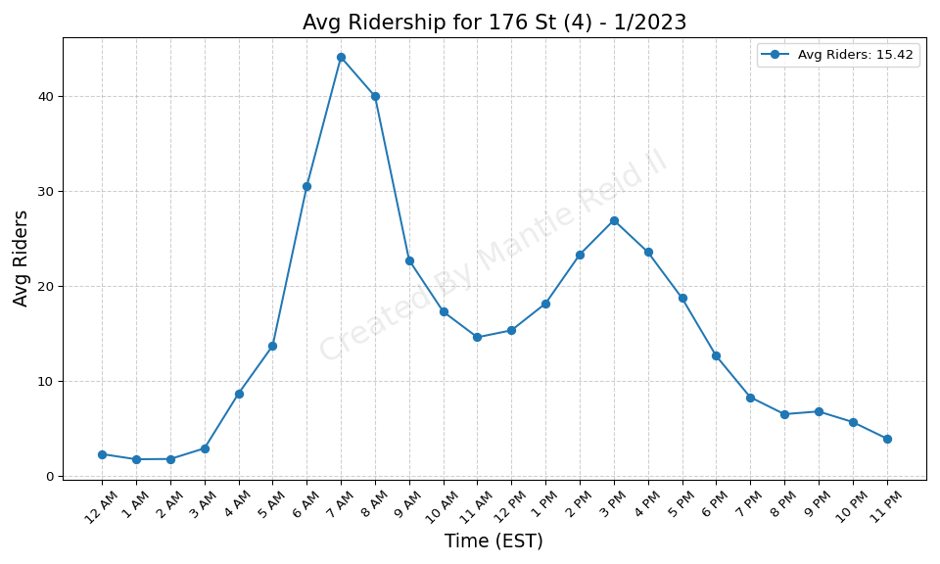
176 St (4) - 1/2023

Slide 32
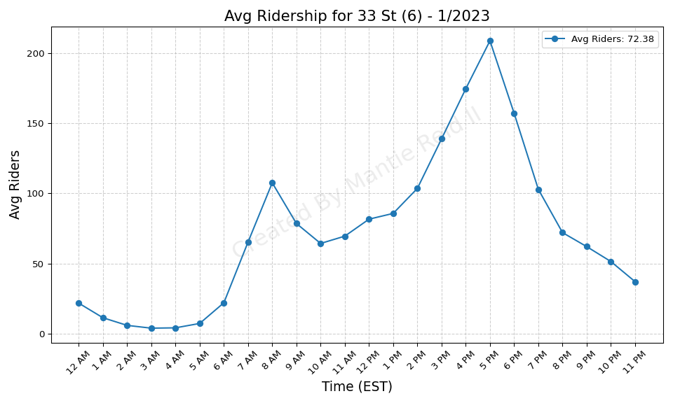
33 St (6) - 1/2023

Slide 33
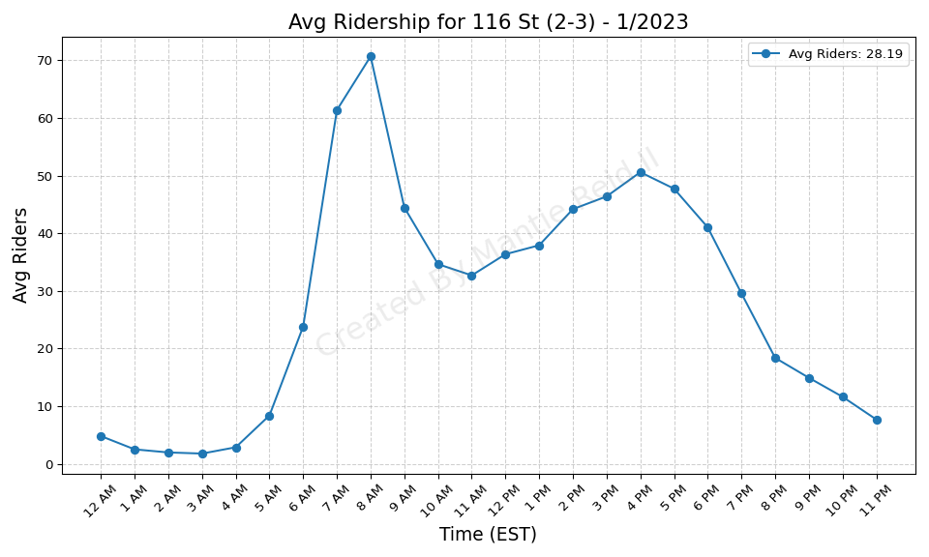
116 St (2-3) - 1/2023

Slide 34
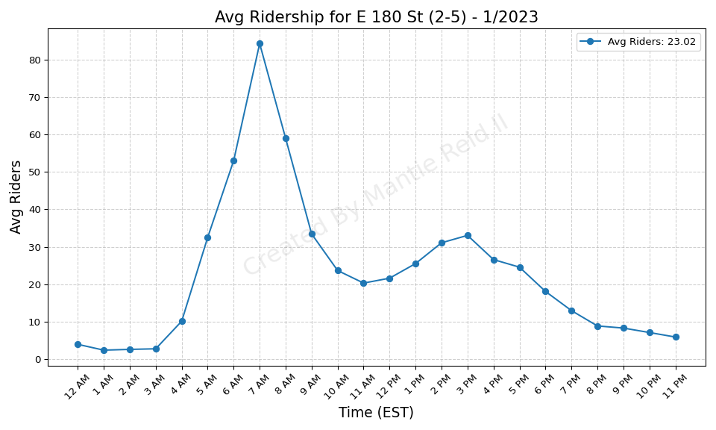
E 180 St (2-5) - 1/2023

Slide 35
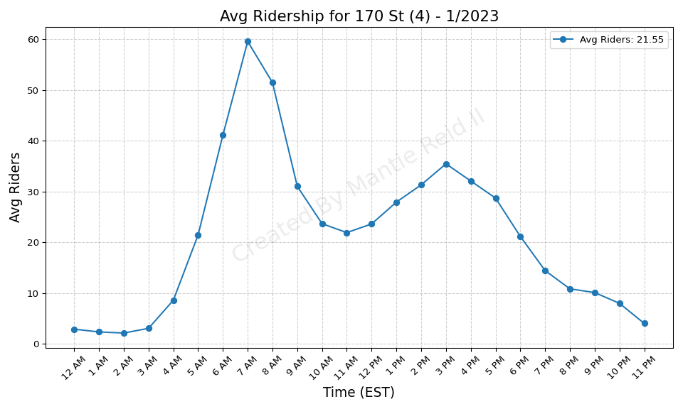
170 St (4) - 1/2023

Slide 36
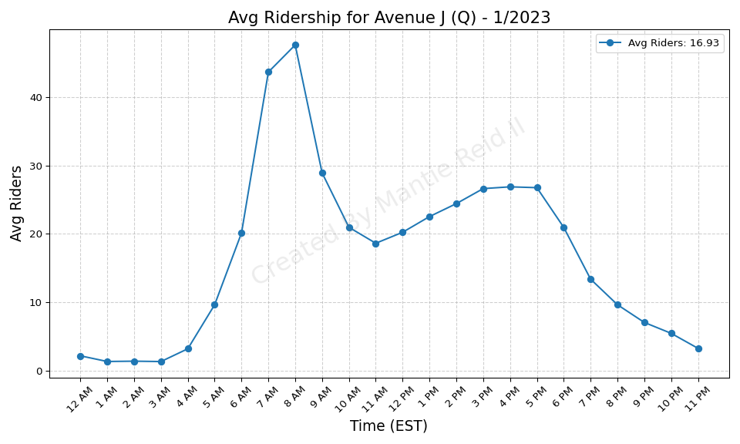
Avenue J (Q) - 1/2023

Slide 37
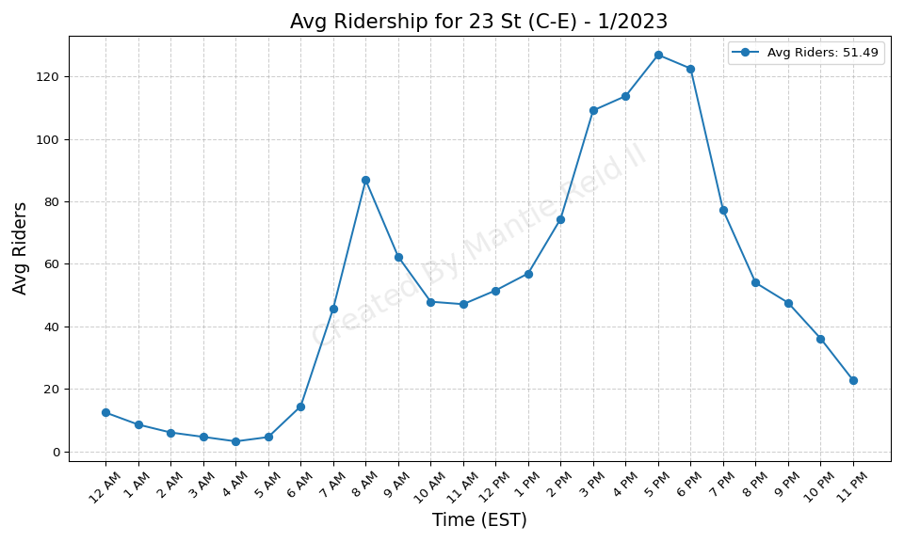
23 St (C-E) - 1/2023

Slide 38
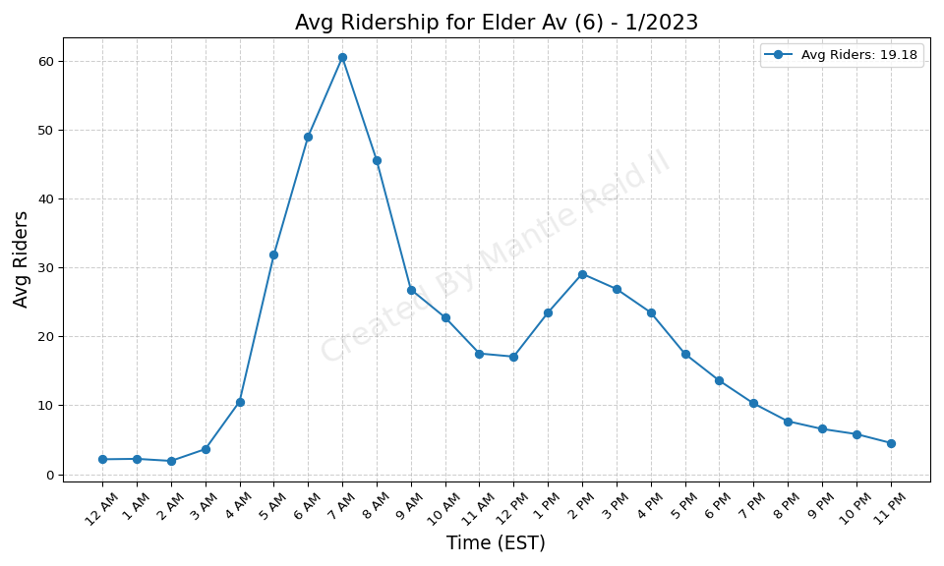
Elder Av (6) - 1/2023

Slide 39
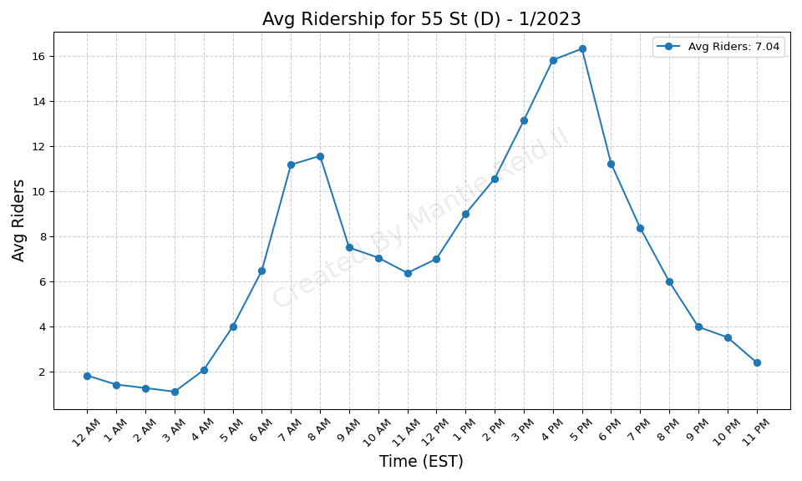
55 St (D) - 1/2023

Slide 40
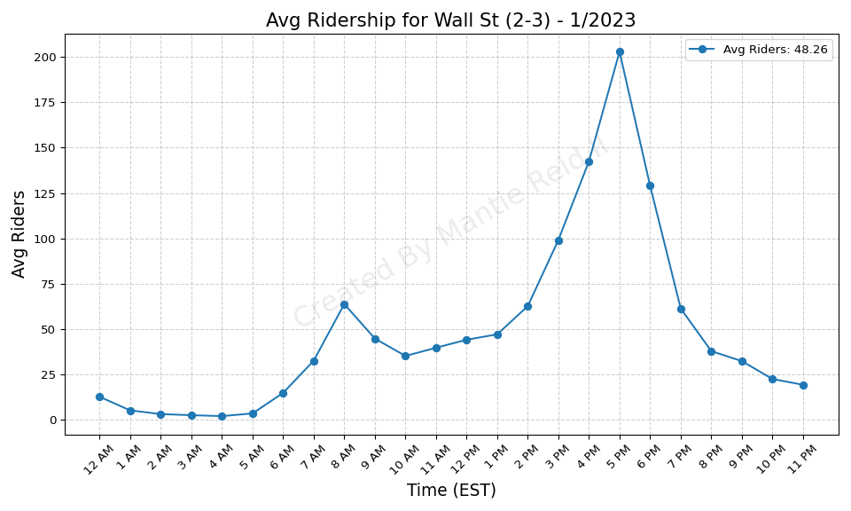
Wall St (2-3) - 1/2023

Slide 41
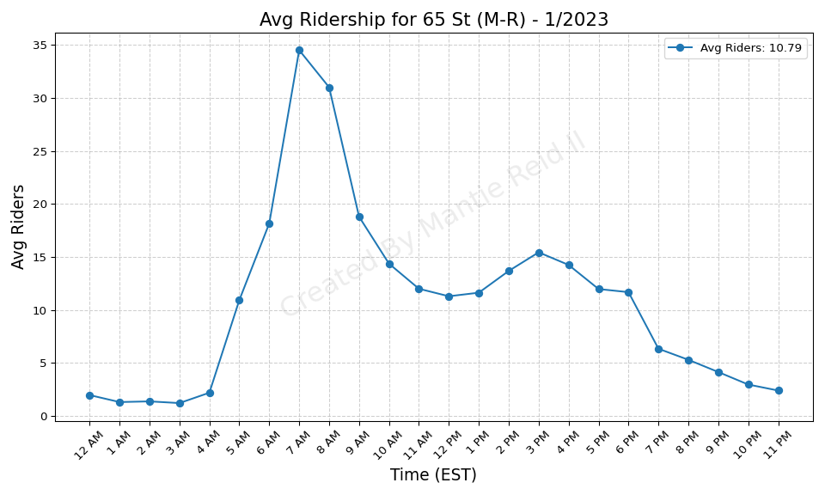
65 St (M-R) - 1/2023

Slide 42
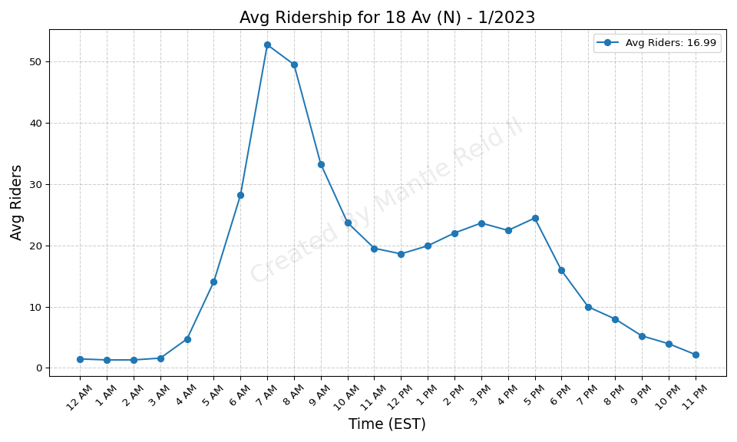
18 Av (N) - 1/2023

Slide 43
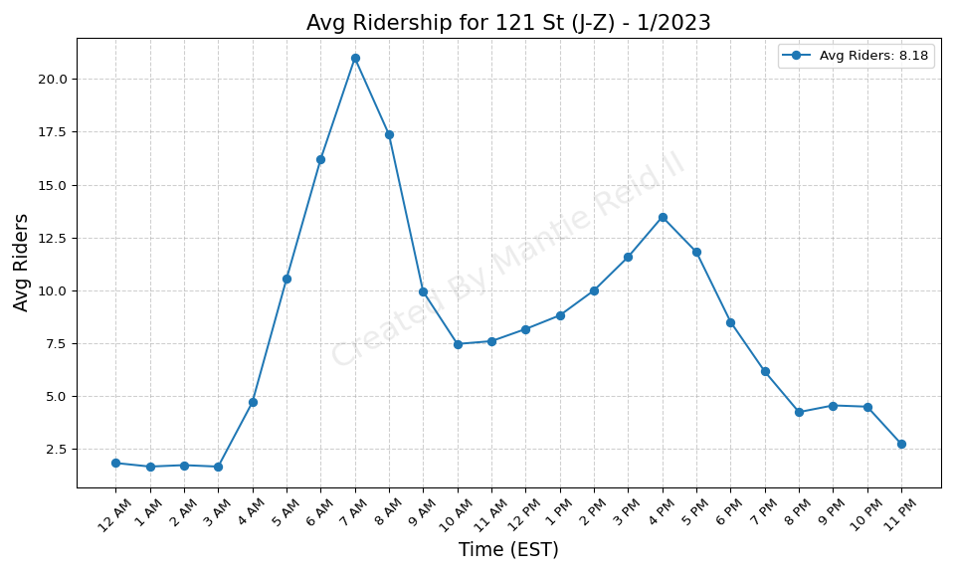
121 St (J-Z) - 1/2023

Slide 44
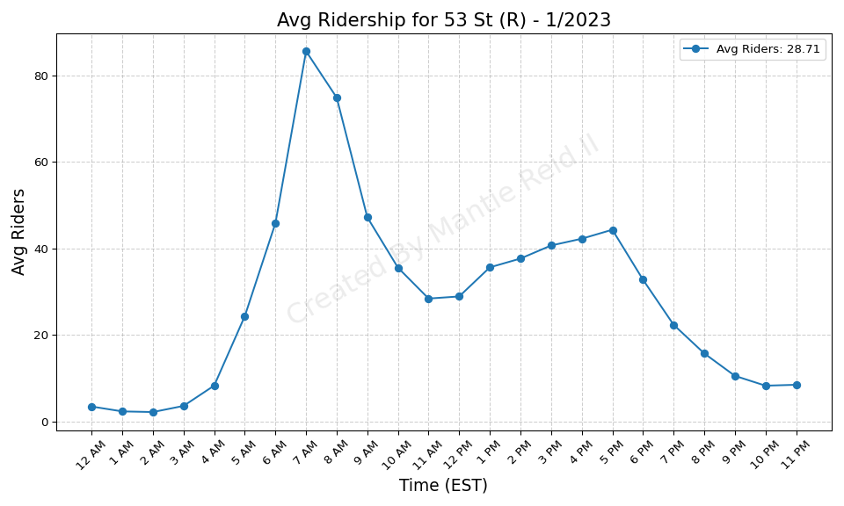
53 St (R) - 1/2023

Slide 45
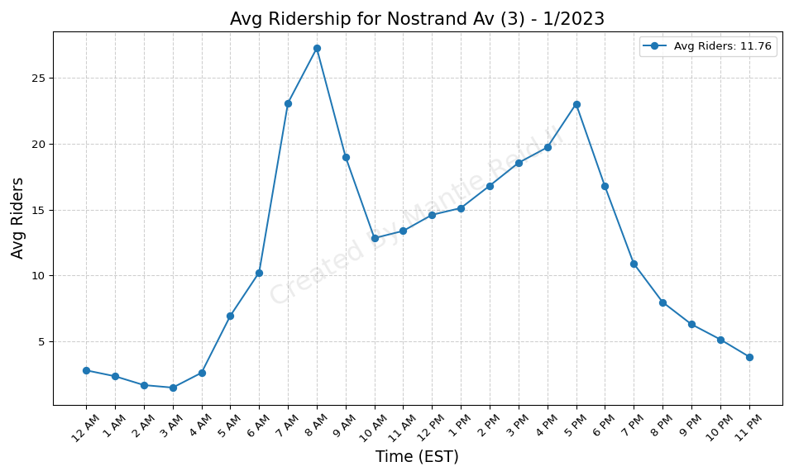
Nostrand Av (3) - 1/2023

Slide 46
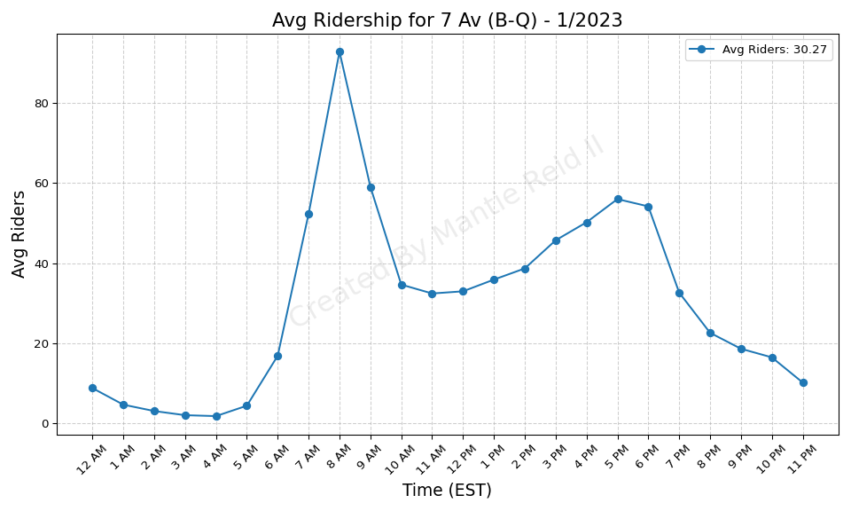
7 Av (B-Q) - 1/2023

Slide 47
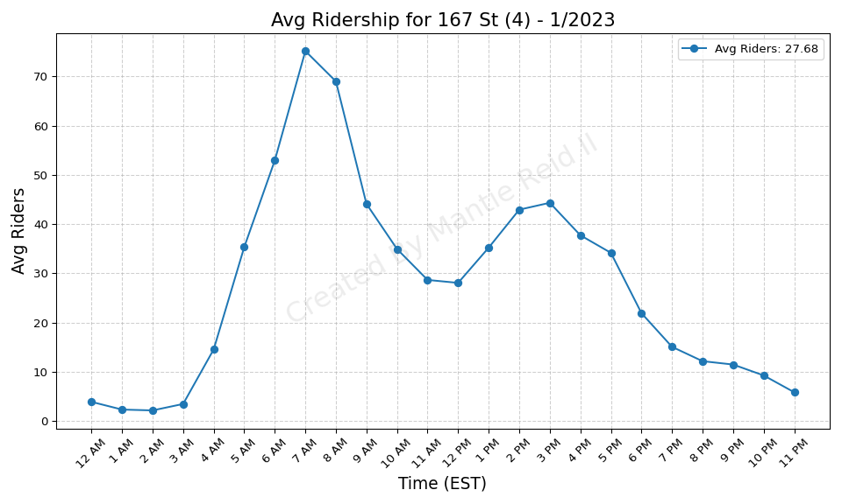
167 St (4) - 1/2023

Slide 48
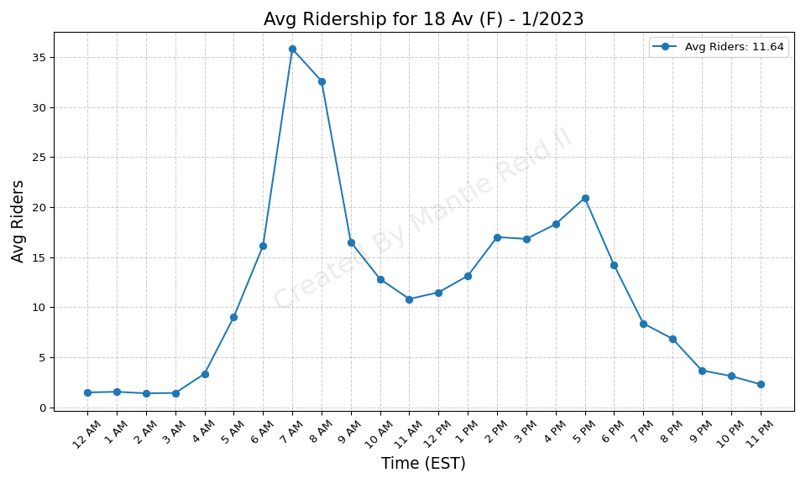
18 Av (F) - 1/2023

Slide 49
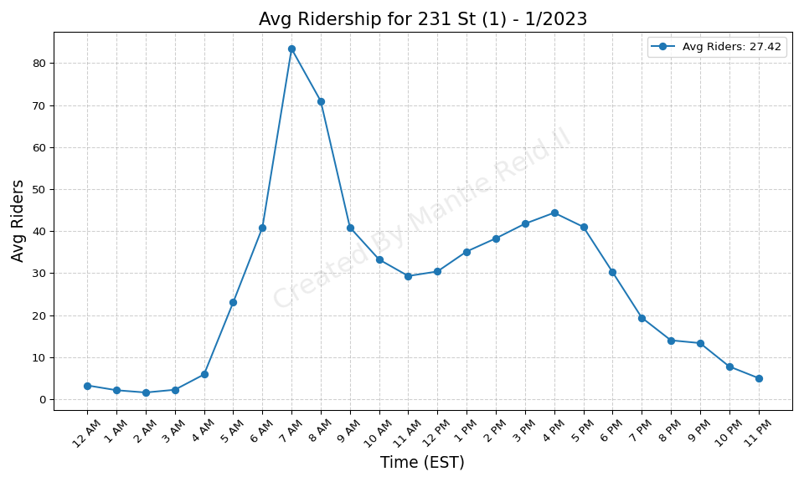
231 St (1) - 1/2023

Slide 50
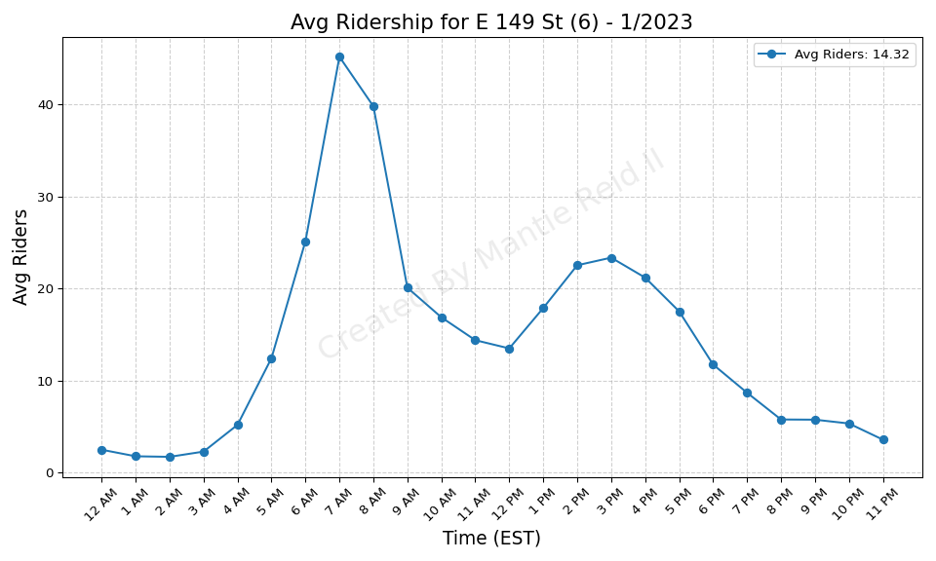
E 149 St (6) - 1/2023

Slide 51
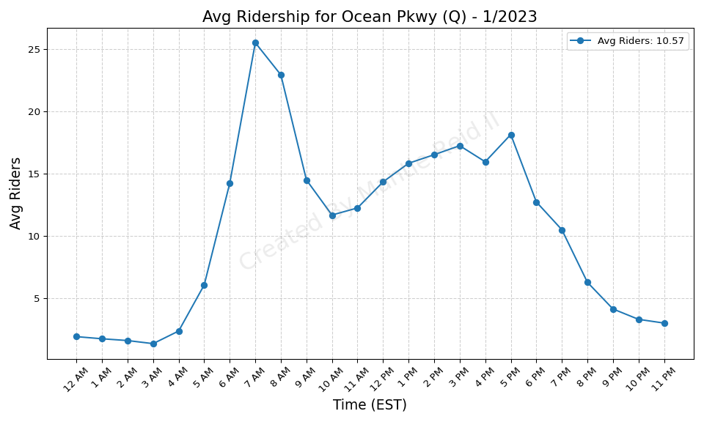
Ocean Pkwy (Q) - 1/2023

Slide 52
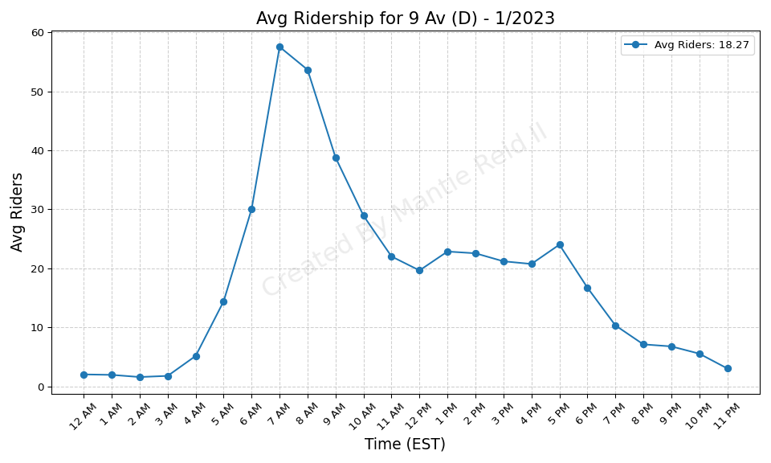
9 Av (D) - 1/2023

Slide 53

Hoyt St (2-3) - 1/2023

Slide 54
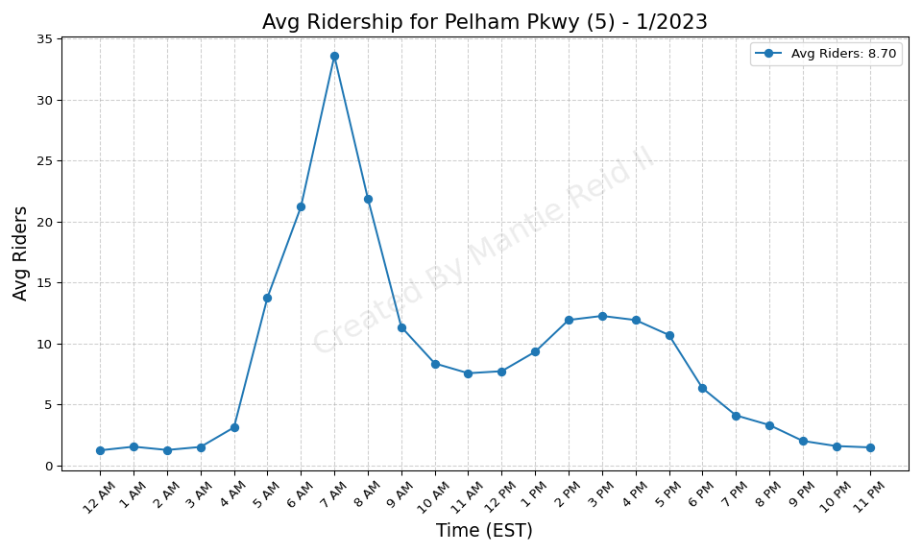
Pelham Pkwy (5) - 1/2023

Slide 55
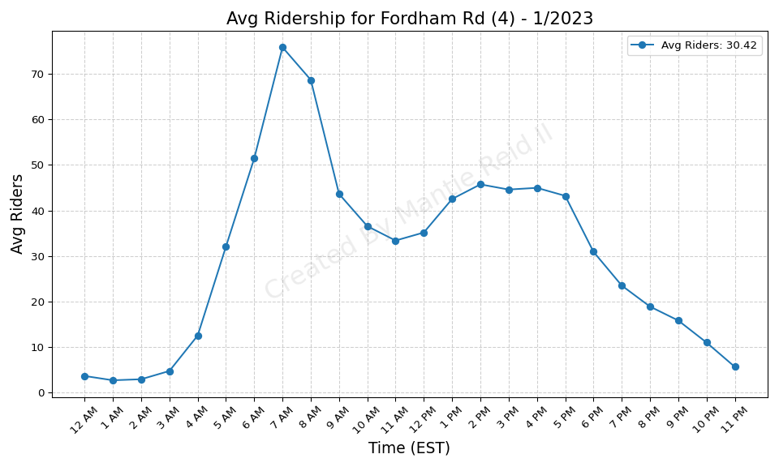
Fordham Rd (4) - 1/2023

Slide 56

Mosholu Pkwy (4) - 1/2023

Slide 57

125 St (2-3) - 1/2023

Slide 58

Morris Park (5) - 1/2023

Slide 59

135 St (2-3) - 1/2023

Slide 60

28 St (R-W) - 1/2023

Slide 61

Central Av (M) - 1/2023

Slide 62

Beach 67 St (A) - 1/2023

Slide 63

Morgan Av (L) - 1/2023

Slide 64

116 St (C-B) - 1/2023

Slide 65

Tremont Av (B-D) - 1/2023

Slide 66

71 St (D) - 1/2023

Slide 67

Zerega Av (6) - 1/2023

Slide 68

Forest Av (M) - 1/2023

Slide 69

Halsey St (L) - 1/2023

Slide 70

Beach 25 St (A) - 1/2023

Slide 71

155 St (C) - 1/2023

Slide 72

49 St (N-R-W) - 1/2023

Slide 73

Beach 60 St (A) - 1/2023

Slide 74

Park Pl (S) - 1/2023

Slide 75

Sutter Av (L) - 1/2023

Slide 76

155 St (B-D) - 1/2023

Slide 77

Seneca Av (M) - 1/2023

Slide 78

Graham Av (L) - 1/2023

Slide 79

Kings Hwy (F) - 1/2023

Slide 80

86 St (1) - 1/2023

Slide 81

Canal St (1) - 1/2023

Slide 82

Junius St (3) - 1/2023

Slide 83

Simpson St (2-5) - 1/2023

Slide 84

Bedford Park Blvd-Lehman Colleg - 1/2023

Slide 85

Intervale Av (2-5) - 1/2023

Slide 86

Canal St (J-N-Q-R-W-Z-6) - 1/2023

Slide 87

Central Park North (110 St) (2- - 1/2023

Slide 88

116 St (6) - 1/2023

Slide 89

Chambers St (1-2-3) - 1/2023

Slide 90

125 St (4-5-6) - 1/2023

Slide 91

Bay Ridge-95 St (R) - 1/2023

Slide 92

Flushing-Main St (7) - 1/2023

Slide 93

Delancey St (F)-Essex St (J-M-Z - 1/2023

Slide 94

Burnside Av (4) - 1/2023

Slide 95

Kingston Av (3) - 1/2023

Slide 96

Woodlawn (4) - 1/2023

Slide 97

Jackson Av (2-5) - 1/2023

Slide 98

Court St (R)-Borough Hall (2-3- - 1/2023

Slide 99

Sutter Av-Rutland Rd (3) - 1/2023

Slide 100

138 St-Grand Concourse (4-5) - 1/2023

Slide 101

Broadway Junction (A-C-J-L-Z) - 1/2023

Slide 102

Church Av (B-Q) - 1/2023

Slide 103

Prospect Av (2-5) - 1/2023

Slide 104

Mets-Willets Point (7) - 1/2023

Slide 105

Brooklyn Bridge-City Hall (4-5- - 1/2023

Slide 106

Baychester Av (5) - 1/2023

Slide 107

3 Av-138 St (6) - 1/2023

Slide 108

Eastchester-Dyre Av (5) - 1/2023

Slide 109

Chambers St (A-C)-WTC (E)-Park - 1/2023

Slide 110

Kingsbridge Rd (4) - 1/2023

Slide 111

3 Av-149 St (2-5) - 1/2023

Slide 112

Crown Hts-Utica Av (3-4) - 1/2023

Slide 113

Nevins St (2-3-4-5) - 1/2023

Slide 114

Eastern Pkwy-Brooklyn Museum (2 - 1/2023

Slide 115

Grand Army Plaza (2-3) - 1/2023

Slide 116

Mt Eden Av (4) - 1/2023

Slide 117

Rector St (1) - 1/2023

Slide 118

Bergen St (2-3) - 1/2023

Slide 119

110 St (6) - 1/2023

Slide 120

Gun Hill Rd (5) - 1/2023

Slide 121

Harlem-148 St (3) - 1/2023

Slide 122

Franklin St (1) - 1/2023

Slide 123

WTC Cortlandt (1) - 1/2023

Slide 124

Clark St (2-3) - 1/2023

Slide 125

Saratoga Av (3) - 1/2023

Slide 126

Franklin Av (2-3-4-5)-Botanic G - 1/2023

Slide 127

Rockaway Av (3) - 1/2023

Slide 128

Bushwick Av-Aberdeen St (L) - 1/2023

Slide 129

175 St (A) - 1/2023

Slide 130

Norwood-205 St (D) - 1/2023

Slide 131

Lorimer St (L)-Metropolitan Av - 1/2023

Slide 132

Woodhaven Blvd (M-R) - 1/2023

Slide 133

South Ferry (1)-Whitehall St (R - 1/2023

Slide 134

Westchester Sq-E Tremont Av (6) - 1/2023

Slide 135

Dyckman St (A) - 1/2023

Slide 136

Bowery (J-Z) - 1/2023

Slide 137

Middle Village-Metropolitan Av - 1/2023

Slide 138

Grand St (L) - 1/2023

Slide 139

75 Av (E-F) - 1/2023

Slide 140

Grand Av-Newtown (M-R) - 1/2023

Slide 141

East 105 St (L) - 1/2023

Slide 142

Hoyt-Schermerhorn Sts (A-C-G) - 1/2023

Slide 143

Rockaway Av (C) - 1/2023

Slide 144

Whitlock Av (6) - 1/2023

Slide 145

Beach 44 St (A) - 1/2023

Slide 146

125 St (A-C-B-D) - 1/2023

Slide 147

Far Rockaway-Mott Av (A) - 1/2023

Slide 148

RI Tramway (Roosevelt) - 1/2023

Slide 149

Broad St (J-Z) - 1/2023

Slide 150

Jay St-MetroTech (A-C-F-R) - 1/2023

Slide 151

167 St (B-D) - 1/2023

Slide 152

135 St (C-B) - 1/2023

Slide 153

Parkchester (6) - 1/2023

Slide 154

New Lots Av (L) - 1/2023

Slide 155

Forest Hills-71 Av (E-F-M-R) - 1/2023

Slide 156

145 St (A-C-B-D) - 1/2023

Slide 157

Montrose Av (L) - 1/2023

Slide 158

86 St (C-B) - 1/2023

Slide 159

W 4 St-Wash Sq (A-C-E-B-D-F-M) - 1/2023

Slide 160

8 St-NYU (R-W) - 1/2023

Slide 161

Inwood-207 St (A) - 1/2023

Slide 162

Elmhurst Av (M-R) - 1/2023

Slide 163

RI Tramway (Manhattan) - 1/2023

Slide 164

Middletown Rd (6) - 1/2023

Slide 165

Lorimer St (M-J) - 1/2023

Slide 166

67 Av (M-R) - 1/2023

Slide 167

Kingsbridge Rd (B-D) - 1/2023

Slide 168

Canarsie-Rockaway Pkwy (L) - 1/2023

Slide 169

182-183 Sts (B-D) - 1/2023

Slide 170

Myrtle-Wyckoff Avs (L-M) - 1/2023

Slide 171

E 143 St-St Mary-s St (6) - 1/2023

Slide 172

Bedford Park Blvd (B-D) - 1/2023

Slide 173

Longwood Av (6) - 1/2023

Slide 174

50 St (C-E) - 1/2023

Slide 175

Hunts Point Av (6) - 1/2023

Slide 176

72 St (C-B) - 1/2023

Slide 177

190 St (A) - 1/2023

Slide 178

Prince St (R-W) - 1/2023

Slide 179

34 St-Penn Station (A-C-E) - 1/2023

Slide 180

Jefferson St (L) - 1/2023

Slide 181

Wilson Av (L) - 1/2023

Slide 182

Castle Hill Av (6) - 1/2023

Slide 183

1 Av (L) - 1/2023

Slide 184

Knickerbocker Av (M) - 1/2023

Slide 185

Beach 36 St (A) - 1/2023

Slide 186

Kew Gardens-Union Tpke (E-F) - 1/2023

Slide 187

Brook Av (6) - 1/2023

Slide 188

Hewes St (M-J) - 1/2023

Slide 189

Cypress Av (6) - 1/2023

Slide 190

Bedford Av (L) - 1/2023

Slide 191

Atlantic Av (L) - 1/2023

Slide 192

Morrison Av-Soundview (6) - 1/2023

Slide 193

81 St-Museum of Natural History - 1/2023

Slide 194

Fresh Pond Rd (M) - 1/2023

Slide 195

Lafayette Av (C) - 1/2023

Slide 196

Fulton St (A-C-J-Z-2-3-4-5) - 1/2023

Slide 197

Rector St (R-W) - 1/2023

Slide 198

Utica Av (A-C) - 1/2023

Slide 199

Astoria-Ditmars Blvd (N-W) - 1/2023

Slide 200

Franklin Av (C-S) - 1/2023

Slide 201

3 Av (L) - 1/2023

Slide 202

Kingston-Throop Avs (C) - 1/2023

Slide 203

163 St-Amsterdam Av (C) - 1/2023

Slide 204

St Lawrence Av (6) - 1/2023

Slide 205

174-175 Sts (B-D) - 1/2023

Slide 206

23 St (R-W) - 1/2023

Slide 207

Cathedral Pkwy (110 St) (C-B) - 1/2023

Slide 208

63 Dr-Rego Park (M-R) - 1/2023

Slide 209

181 St (A) - 1/2023

Slide 210

Spring St (C-E) - 1/2023

Slide 211

Beach 105 St (A-S) - 1/2023

Slide 212

Rockaway Park-Beach 116 St (A-S - 1/2023

Slide 213

Marcy Av (M-J-Z) - 1/2023

Slide 214

Livonia Av (L) - 1/2023

Slide 215

Canal St (A-C-E) - 1/2023

Slide 216

96 St (C-B) - 1/2023

Slide 217

Nostrand Av (A-C) - 1/2023

Slide 218

Clinton-Washington Avs (C) - 1/2023

Slide 219

DeKalb Av (B-Q-R) - 1/2023

Slide 220

103 St (C-B) - 1/2023

Slide 221

Northern Blvd (M-R) - 1/2023

Slide 222

High St (A-C) - 1/2023

Slide 223

Ralph Av (C) - 1/2023

Slide 224

DeKalb Av (L) - 1/2023

Slide 225

21 St-Queensbridge (F) - 1/2023

Slide 226

Briarwood (E-F) - 1/2023

Slide 227

Winthrop St (2-5) - 1/2023

Slide 228

Beach 98 St (A-S) - 1/2023

Slide 229

Queens Plaza (E-M-R) - 1/2023

Slide 230

Houston St (1) - 1/2023

Slide 231

Jamaica-179 St (F) - 1/2023

Slide 232

Fulton St (G) - 1/2023

Slide 233

Jamaica-Van Wyck (E) - 1/2023

Slide 234

Neptune Av (F) - 1/2023

Slide 235

Smith-9 Sts (F-G) - 1/2023

Slide 236

111 St (A) - 1/2023

Slide 237

7 Av (F-G) - 1/2023

Slide 238

Myrtle-Willoughby Avs (G) - 1/2023

Slide 239

Burke Av (2-5) - 1/2023

Slide 240

96 St (1-2-3) - 1/2023

Slide 241

34 St-Penn Station (1-2-3) - 1/2023

Slide 242

Jamaica Center-Parsons-Archer ( - 1/2023

Slide 243

Church Av (2-5) - 1/2023

Slide 244

Howard Beach-JFK Airport (A) - 1/2023

Slide 245

Bay Ridge Av (R) - 1/2023

Slide 246

18 St (1) - 1/2023

Slide 247

Beach 90 St (A-S) - 1/2023

Slide 248

Pennsylvania Av (3) - 1/2023

Slide 249

New Lots Av (3) - 1/2023

Slide 250

59 St (N-R) - 1/2023

Slide 251

Allerton Av (2-5) - 1/2023

Slide 252

Flatbush Av-Brooklyn College (2 - 1/2023

Slide 253

104 St (A) - 1/2023

Slide 254

Parsons Blvd (F) - 1/2023

Slide 255

Bedford-Nostrand Avs (G) - 1/2023

Slide 256

225 St (2-5) - 1/2023

Slide 257

Newkirk Av-Little Haiti (2-5) - 1/2023

Slide 258

Van Siclen Av (C) - 1/2023

Slide 259

36 St (D-N-R) - 1/2023

Slide 260

57 St (F) - 1/2023

Slide 261

23 St (F-M) - 1/2023

Slide 262

Avenue P (F) - 1/2023

Slide 263

Avenue X (F) - 1/2023

Slide 264

Van Siclen Av (3) - 1/2023

Slide 265

Classon Av (G) - 1/2023

Slide 266

Nassau Av (G) - 1/2023

Slide 267

Beverly Rd (2-5) - 1/2023

Slide 268

Avenue I (F) - 1/2023

Slide 269

Prospect Park (B-Q-S) - 1/2023

Slide 270

Avenue N (F) - 1/2023

Slide 271

Nereid Av (2-5) - 1/2023

Slide 272

Sutphin Blvd-Archer Av-JFK Airp - 1/2023

Slide 273

7 Av (E-B-D) - 1/2023

Slide 274

Aqueduct Racetrack (A) - 1/2023

Slide 275

Grand St (B-D) - 1/2023

Slide 276

96 St (6) - 1/2023

Slide 277

47-50 Sts-Rockefeller Ctr (B-D- - 1/2023

Slide 278

Sterling St (2-5) - 1/2023

Slide 279

President St-Medgar Evers Colle - 1/2023

Slide 280

80 St (A) - 1/2023

Slide 281

Church Av (F-G) - 1/2023

Slide 282

West Farms Sq-E Tremont Av (2-5 - 1/2023

Slide 283

Carroll St (F-G) - 1/2023

Slide 284

Euclid Av (A-C) - 1/2023

Slide 285

Clinton-Washington Avs (G) - 1/2023

Slide 286

86 St (4-5-6) - 1/2023

Slide 287

Astoria Blvd (N-W) - 1/2023

Slide 288

Broadway (G) - 1/2023

Slide 289

Greenpoint Av (G) - 1/2023

Slide 290

Bergen St (F-G) - 1/2023

Slide 291

Bronx Park East (2-5) - 1/2023

Slide 292

Van Cortlandt Park-242 St (1) - 1/2023

Slide 293

Union St (R) - 1/2023

Slide 294

Liberty Av (C) - 1/2023

Slide 295

28 St (1) - 1/2023

Slide 296

City Hall (R-W) - 1/2023

Slide 297

103 St (6) - 1/2023

Slide 298

Steinway St (M-R) - 1/2023

Slide 299

Pelham Pkwy (2-5) - 1/2023

Slide 300

66 St-Lincoln Center (1) - 1/2023

Slide 301

East Broadway (F) - 1/2023

Slide 302

46 St (M-R) - 1/2023

Slide 303

Grant Av (A) - 1/2023

Slide 304

Shepherd Av (C) - 1/2023

Slide 305

Christopher St-Sheridan Sq (1) - 1/2023

Slide 306

Aqueduct-N Conduit Av (A) - 1/2023

Slide 307

Pelham Bay Park (6) - 1/2023

Slide 308

Sutphin Blvd (F) - 1/2023

Slide 309

Gun Hill Rd (2-5) - 1/2023

Slide 310

5 Av-53 St (E-M) - 1/2023

Slide 311

Avenue U (F) - 1/2023

Slide 312

York St (F) - 1/2023

Slide 313

Broad Channel (A-S) - 1/2023

Slide 314

Parkside Av (Q) - 1/2023

Slide 315

Ozone Park-Lefferts Blvd (A) - 1/2023

Slide 316

Fort Hamilton Pkwy (F-G) - 1/2023

Slide 317

Lexington Av-63 St (F-Q) - 1/2023

Slide 318

72 St (1-2-3) - 1/2023

Slide 319

36 St (M-R) - 1/2023

Slide 320

Flushing Av (G) - 1/2023

Slide 321

219 St (2-5) - 1/2023

Slide 322

79 St (1) - 1/2023

Slide 323

Bay Pkwy (F) - 1/2023

Slide 324

Roosevelt Island (F) - 1/2023

Slide 325

15 St-Prospect Park (F-G) - 1/2023

Slide 326

Rockaway Blvd (A) - 1/2023

Slide 327

Wakefield-241 St (2) - 1/2023

Slide 328

Freeman St (2-5) - 1/2023

Slide 329

23 St (1) - 1/2023

Slide 330

103 St (1) - 1/2023

Slide 331

207 St (1) - 1/2023

Slide 332

Avenue H (Q) - 1/2023

Slide 333

Kings Hwy (N) - 1/2023

Slide 334

8 Av (N) - 1/2023

Slide 335

Junction Blvd (7) - 1/2023

Slide 336

Broadway (N-W) - 1/2023

Slide 337

Bay 50 St (D) - 1/2023

Slide 338

Fort Hamilton Pkwy (D) - 1/2023

Slide 339

Alabama Av (J) - 1/2023

Slide 340

111 St (J) - 1/2023

Slide 341

39 Av-Dutch Kills (N-W) - 1/2023

Slide 342

28 St (6) - 1/2023

Slide 343

W 8 St-NY Aquarium (F-Q) - 1/2023

Slide 344

Marble Hill-225 St (1) - 1/2023

Slide 345

125 St (1) - 1/2023

Slide 346

215 St (1) - 1/2023

Slide 347

Norwood Av (J-Z) - 1/2023

Slide 348

Halsey St (J) - 1/2023

Slide 349

Cortelyou Rd (Q) - 1/2023

Slide 350

59 St-Columbus Circle (A-B-C-D- - 1/2023

Slide 351

Broadway-Lafayette St (B-D-F-M) - 1/2023

Slide 352

Court Sq (E-G-M-7) - 1/2023

Slide 353

Vernon Blvd-Jackson Av (7) - 1/2023

Slide 354

72 St (Q) - 1/2023

Slide 355

Bay Pkwy (D) - 1/2023

Slide 356

Astor Pl (6) - 1/2023

Slide 357

14 St (F-M-1-2-3)-6 Av (L) - 1/2023

Slide 358

Bay Pkwy (N) - 1/2023

Slide 359

Cleveland St (J) - 1/2023

Slide 360

96 St (Q) - 1/2023

Slide 361

St George (SIR) - 1/2023

Slide 362

Kings Hwy (B-Q) - 1/2023

Slide 363

Coney Island-Stillwell Av (D-F- - 1/2023

Slide 364

Spring St (6) - 1/2023

Slide 365

57 St-7 Av (N-Q-R-W) - 1/2023

Slide 366

75 St-Elderts Ln (J-Z) - 1/2023

Slide 367

34 St-Hudson Yards (7) - 1/2023

Slide 368

82 St-Jackson Hts (7) - 1/2023

Slide 369

Avenue U (N) - 1/2023

Slide 370

104 St (J-Z) - 1/2023

Slide 371

5 Av-59 St (N-R-W) - 1/2023

Slide 372

4 Av (F-G)-9 St (R) - 1/2023

Slide 373

Neck Rd (Q) - 1/2023

Slide 374

168 St (A-C-1) - 1/2023

Slide 375

Cathedral Pkwy (110 St) (1) - 1/2023

Slide 376

34 St-Herald Sq (B-D-F-M-N-Q-R- - 1/2023

Slide 377

Avenue U (Q) - 1/2023

Slide 378

Wall St (4-5) - 1/2023

Slide 379

Lexington Av-53 St (E-M)-51 St - 1/2023

Slide 380

157 St (1) - 1/2023

Slide 381

61 St-Woodside (7) - 1/2023

Slide 382

77 St (6) - 1/2023

Slide 383

191 St (1) - 1/2023

Slide 384

Beverley Rd (Q) - 1/2023

Slide 385

Woodhaven Blvd (J-Z) - 1/2023

Slide 386

Queensboro Plaza (7-N-W) - 1/2023

Slide 387

145 St (1) - 1/2023

Slide 388

Chauncey St (J-Z) - 1/2023

Slide 389

Fort Hamilton Pkwy (N) - 1/2023

Slide 390

149 St-Grand Concourse (2-4-5) - 1/2023

Slide 391

Tompkinsville (SIR) - 1/2023

Slide 392

Dyckman St (1) - 1/2023

Slide 393

137 St-City College (1) - 1/2023

Slide 394

103 St-Corona Plaza (7) - 1/2023

Slide 395

New Utrecht Av (N)-62 St (D) - 1/2023

Slide 396

Gates Av (J-Z) - 1/2023

Slide 397

68 St-Hunter College (6) - 1/2023

Slide 398

33 St-Rawson St (7) - 1/2023

Slide 399

14 St (A-C-E)-8 Av (L) - 1/2023

Slide 400

Brighton Beach (B-Q) - 1/2023

Slide 401

Prospect Av (R) - 1/2023

Slide 402

Atlantic Av-Barclays Ctr (B-D-N - 1/2023

Slide 403

Newkirk Plaza (B-Q) - 1/2023

Slide 404

14 St-Union Sq (L-N-Q-R-W-4-5-6 - 1/2023

Slide 405

40 St-Lowery St (7) - 1/2023

Slide 406

161 St-Yankee Stadium (B-D-4) - 1/2023

Slide 407

86 St (N) - 1/2023

Slide 408

46 St-Bliss St (7) - 1/2023

Slide 409

Bryant Pk (B-D-F-M)-5 Av (7) - 1/2023

Slide 410

Van Siclen Av (J-Z) - 1/2023

Slide 411

Bowling Green (4-5) - 1/2023

Slide 412

Times Sq-42 St (N-Q-R-W-S-1-2-3 - 1/2023

Slide 413

116 St-Columbia University (1) - 1/2023

Slide 414

20 Av (N) - 1/2023

Slide 415

Avenue M (Q) - 1/2023

Slide 416

Hunters Point Av (7) - 1/2023

Slide 417

Crescent St (J-Z) - 1/2023

Slide 418

Sheepshead Bay (B-Q) - 1/2023

Slide 419

74-Broadway (7)-Jackson Hts-Roo - 1/2023

Slide 420

85 St-Forest Pkwy (J) - 1/2023

Slide 421

Grand Central-42 St (S-4-5-6-7) - 1/2023

Slide 422

Cypress Hills (J) - 1/2023

Slide 423

Lexington Av (N-R-W)-59 St (4-5 - 1/2023

Slide 424

90 St-Elmhurst Av (7) - 1/2023

Slide 425

20 Av (D) - 1/2023

Slide 426

Kosciuszko St (J) - 1/2023

Slide 427

Myrtle Av (M-J-Z) - 1/2023

Slide 428

Flushing Av (M-J) - 1/2023

